Slide 1

Customer Data Management and Analysis Team 1

Slide 2

Team
Youssef Lawendy (Leader)
Ahd Islam
Alaa Magdi
Farah Walid
Kirollos Ehab

Slide 3

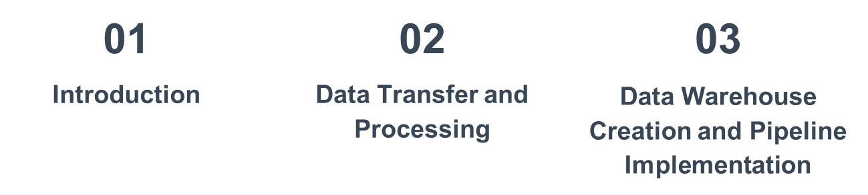
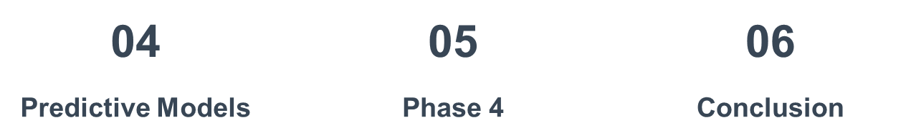

Slide 4
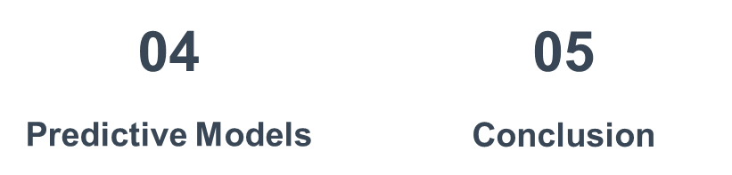

Slide 5
Table of contents
01
02
03
04
05
Introduction
Data Transfer and Processing
Data Warehouse Creation and Pipeline Implementation
Predictive Models
Conclusion

Slide 6

01
Introduction

Slide 7
Introduction
In today’s data-driven world, customer data is the key to understanding business performance and enhancing customer experience.
Our project focuses on migrating customer data, improving its quality through cleaning and transformation, and leveraging machine learning models to gain insights and enhance decision-making. Our approach combined data engineering and data science techniques to create a robust solution for business analysis.

Slide 8

02
Data Transfer and Processing

Slide 9
Data Transfer and Processing
Data Transfer to SQL Database:
Data Transformation:
CSV files were imported into the SQL database for processing and analysis.
Data was transformed to meet the required format and quality standards.

Slide 10
03
Data Warehouse Creation and Pipeline Implementation

Slide 11

Data Warehouse Creation and Pipeline Implementation
Data Warehouse Creation:
Data Pipeline Implementation:
A data warehouse was established on Azure to store and manage large volumes of structured data.
A data pipeline was created to:
Compare data between the dimension table and CSV files.
Identify new entries based on the surrogate key.
Update the dimension table with new entries.

Slide 12
04
Predictive Models

Slide 13

Joining Databases

Slide 14
Feature Engineering
Features before:
The dataset initially included columns such as review_comment_title, review_comment_message, timestamps (order_purchase_timestamp, order_approved_at, etc.), customer, product, seller information, and review data.
Missing and duplicate values were present.
No churn or other derived metrics were available.

Slide 15
Feature Engineering
Transformations Applied:
Removed columns: review_comment_title, review_comment_message, delivery_time (after calculating).
Dropped missing values: Cleaned up missing data by removing rows with null values. As theyr were very small compared to rest of data ~1k rows

Slide 16
Feature Engineering
churn: Identified customers with one order as churned.
order_processing_time: Time between purchase and approval in hours.
shipping_delay: Time difference between actual delivery and estimated delivery.
actual_delivery_time: Time between purchase and actual delivery.
delivery_speed: Time between carrier delivery and customer delivery.
customer_order_frequency: Count of orders per customer.
customer_review_average: Average review score per customer.

Slide 17
Feature Engineering
customer_review_response_time: Time between review creation and response in hours.
product_popularity: Number of orders for each product.
seller_popularity: Number of orders per seller.
same_state: Binary indicator if the customer and seller are from the same state.
is_high_value_order: Binary indicator if the order value exceeds the 75th percentile.
product_avg_review_score: Average review score for each product.
seller_avg_review_score: Average review score for each seller.

Slide 18
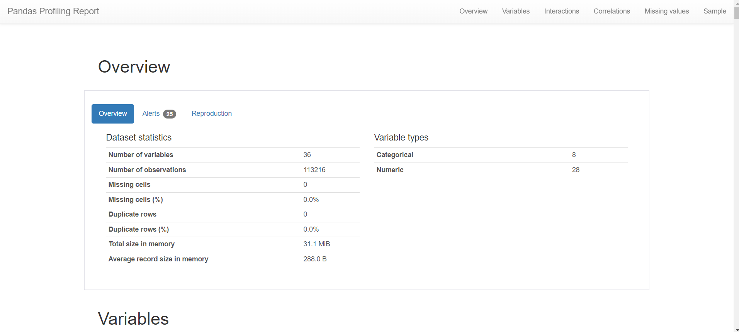
Exploratory Data Analysis
Used ydata_profiling (Pandas Profiling) to generate a profile report

Slide 19
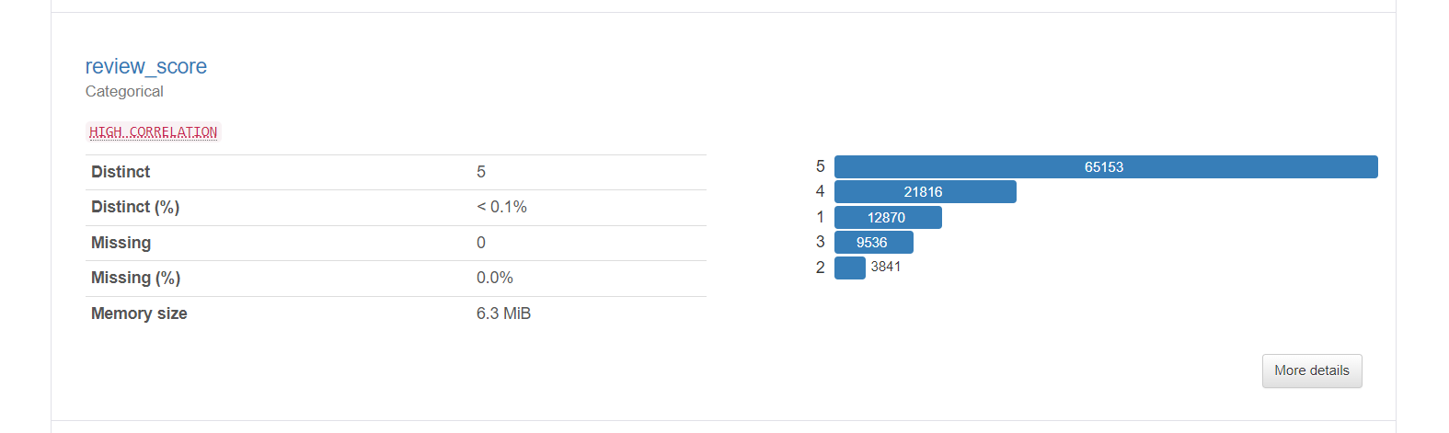
Exploratory Data Analysis
Shows useful insights about the data

Slide 20
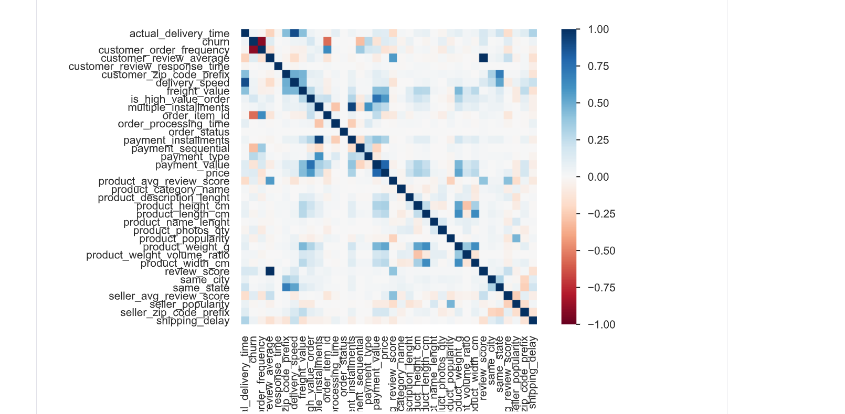
Exploratory Data Analysis
Shows useful insights about the data

Slide 21
Predictive Modeling
Churn Model (Random Forest Classifier):
Accuracy: 96.3%
Recall: 99%
Precision: 94.9%
F1 Score: 97.4%
Review Model (Random Forest Classifier):
Accuracy: 96.4%
Class 1: Recall - 99.4%, Precision - 97.4%
Class 2: Recall - 99.8%, Precision - 99.8%
Class 3: Recall - 99.1%, Precision - 90.0%
Class 4: Recall - 29.6%, Precision - 93.5%
Class 5: Recall - 93.6%, Precision - 99.5%

Slide 22
Predictive Modeling
Sales Model Performance
(Linear Regression)
Mean Squared Error (MSE): 0.0093
Root Mean Squared Error (RMSE): 0.0964
Mean Absolute Error (MAE): 0.0079
R² Score: 0.995
Sales Model Performance (XGboost)
Mean Squared Error (MSE): 0.009559
Root Mean Squared Error (RMSE): 0.097771
Mean Absolute Error (MAE): 0.00812
R² Score:0.994771

Slide 23
Predictive Modeling
Sales Model Performance (Randomforset)
Mean Squared Error (MSE): 0.008786
Root Mean Squared Error (RMSE): 0.093733
Mean Absolute Error (MAE): 0.006995
R² Score:0.995194
Churn Prediction & Review Prediction: Random Forest classifier performed well in predicting them.
Sales Prediction: Linear Regression had high predictive accuracy.

Slide 24
05
Mlflow & Deployment

Slide 25
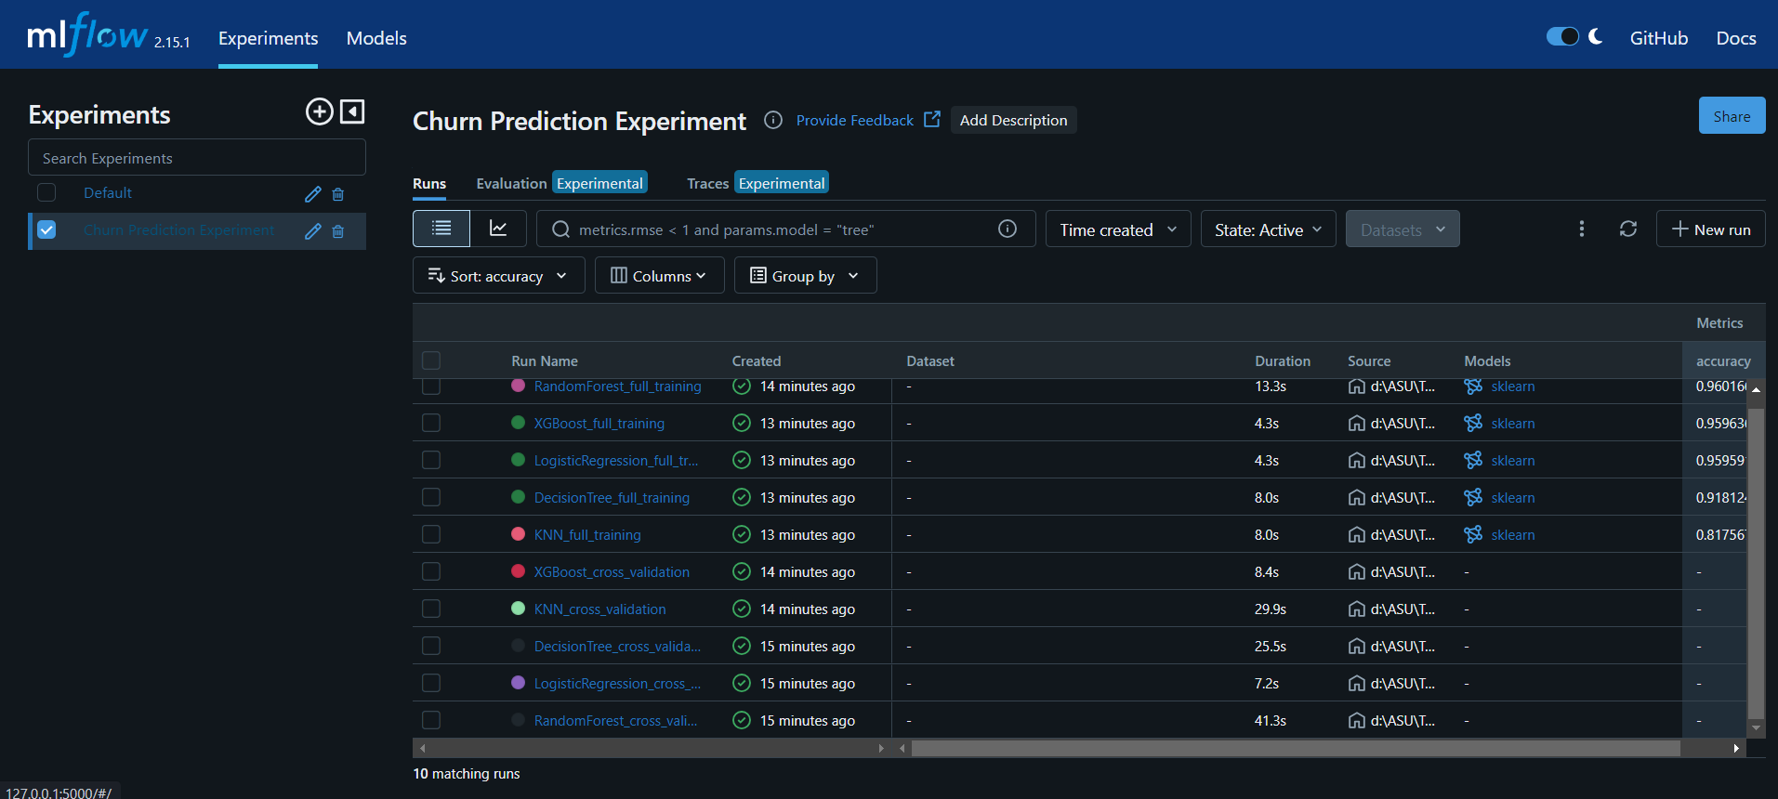
Mlflow
Mlflow was used to track experiments done for Churn Model Prediction
Applying cross validation
Training Model after cross validation

Slide 26
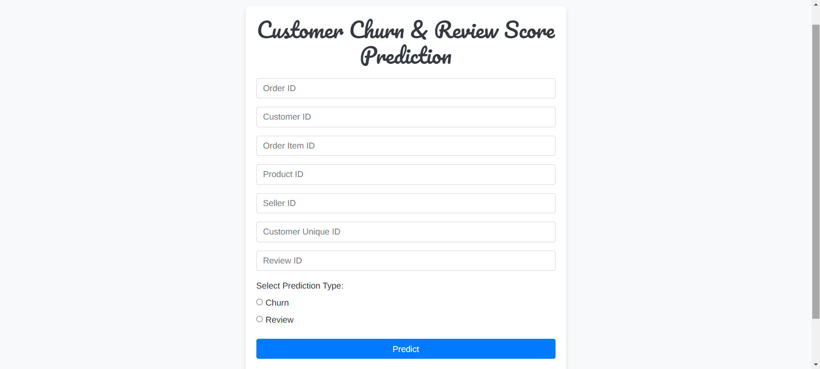
Flask
Flask was used for deploying Churn Model and Review Score Model

Slide 27

05
Conclusion

Slide 28
06
Conclusion

Slide 29
Conclusion
The project successfully applied machine learning models to extract valuable business insights. The models demonstrated strong performance in predicting customer churn, sales, and delivery outcomes. Key to this success was the continuous focus on data quality, preprocessing, and feature engineering.

Slide 30
Links and Resources
Kaggle dataset: https://www.kaggle.com/datasets/olistbr/brazilian-ecommerce?select=olist_geolocation_dataset.csv
Feature engineering and modeling: https://colab.research.google.com/drive/1HMA0RB8xFGreLWcpDxVWY76fAthayX9E?usp=sharing
EDA and Preprocessing: https://colab.research.google.com/drive/1ibdPIw9vpNrdCZm599PUFVIJlchjnpFT?usp=sharing

Slide 31
Thanks! Do you have any Questions?

